Slide 1
AZURE PROJECT
LEKSHMI PRIYA N-214386

Slide 2
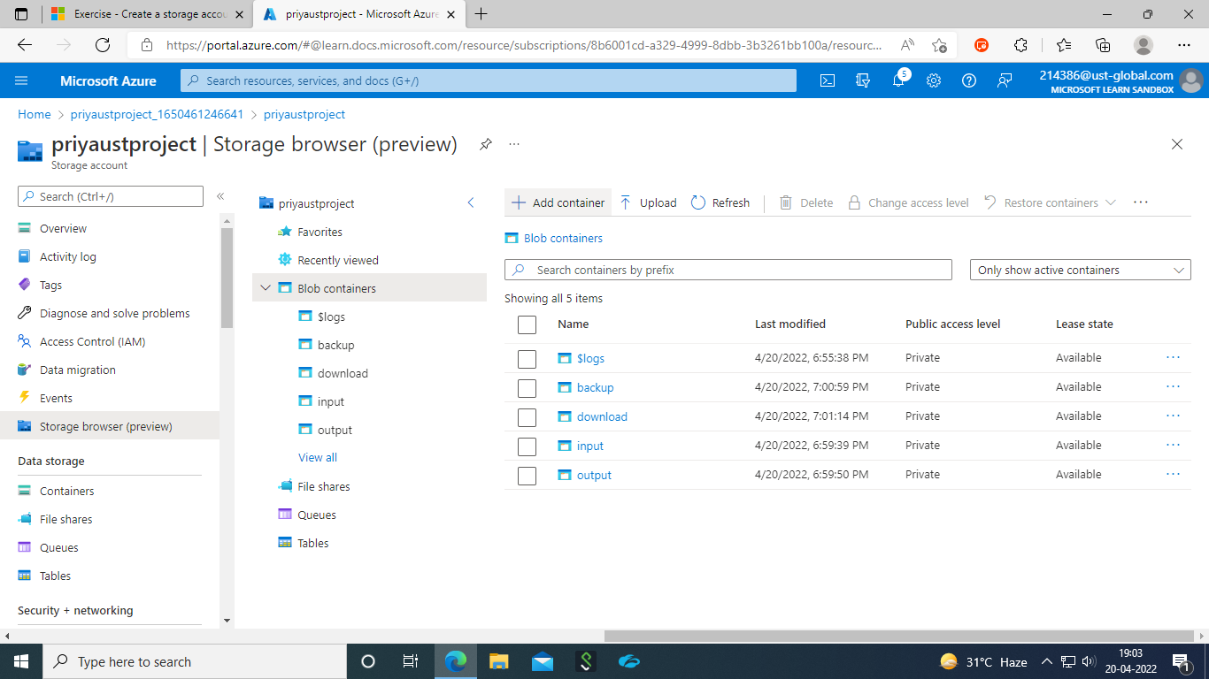
STORAGE ACCOUNT WITH 4 CONTAINERS

Slide 3
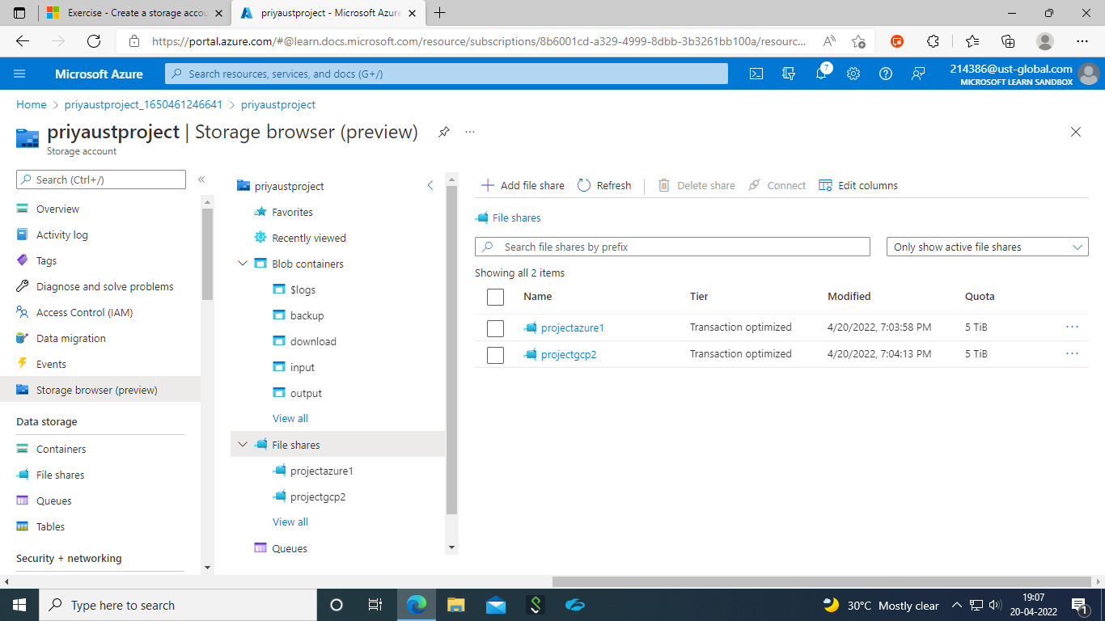
FILESHARE WITH 2 DIRECTORIES

Slide 4
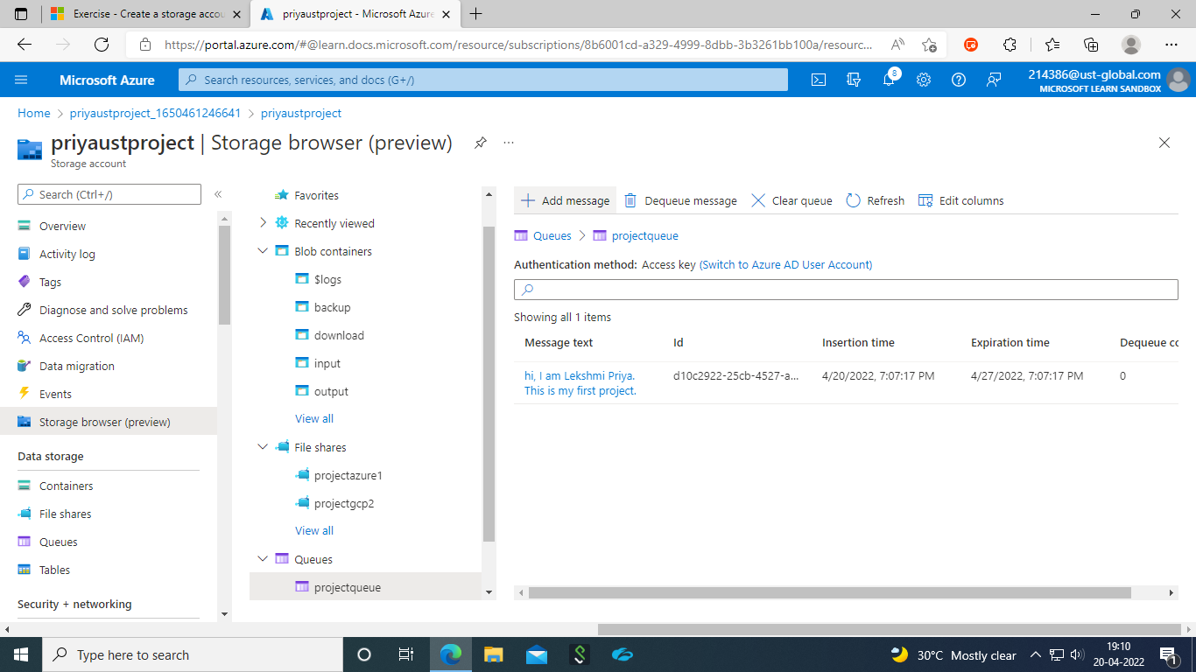
MESSAGE QUEUE WITH MESSAGE

Slide 5
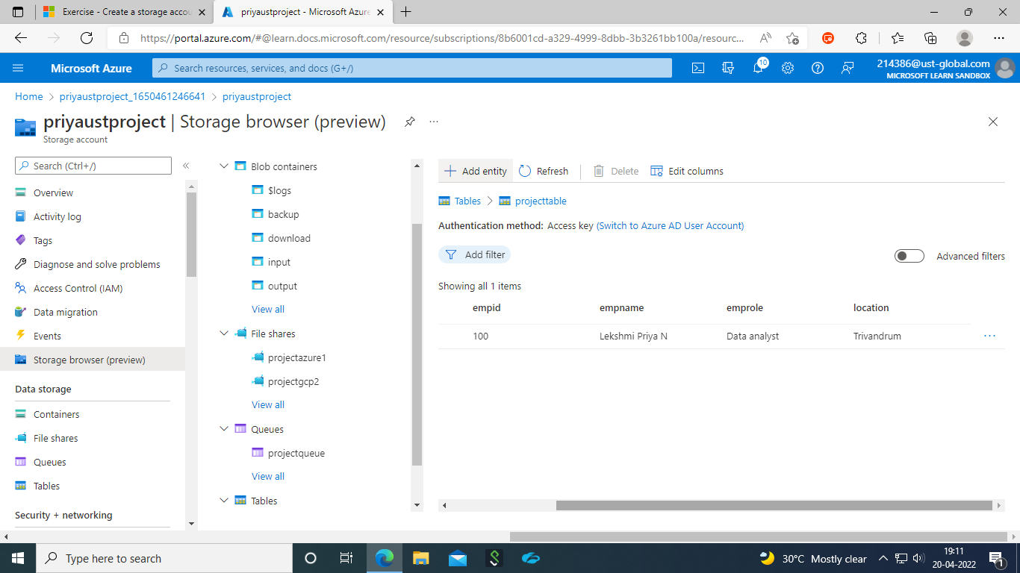
TABLE

Slide 6
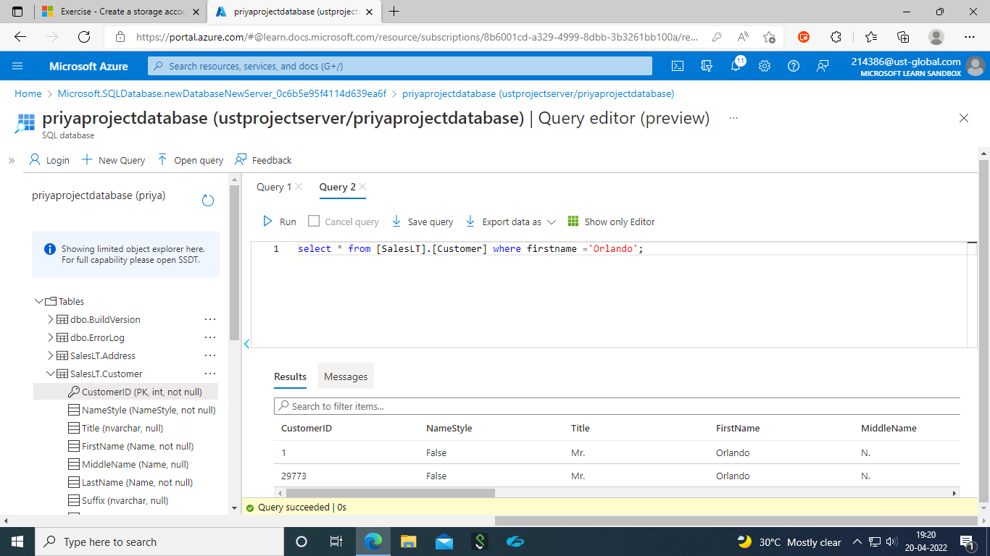
SAMPLE DATABASE WITH QUERY

Slide 7
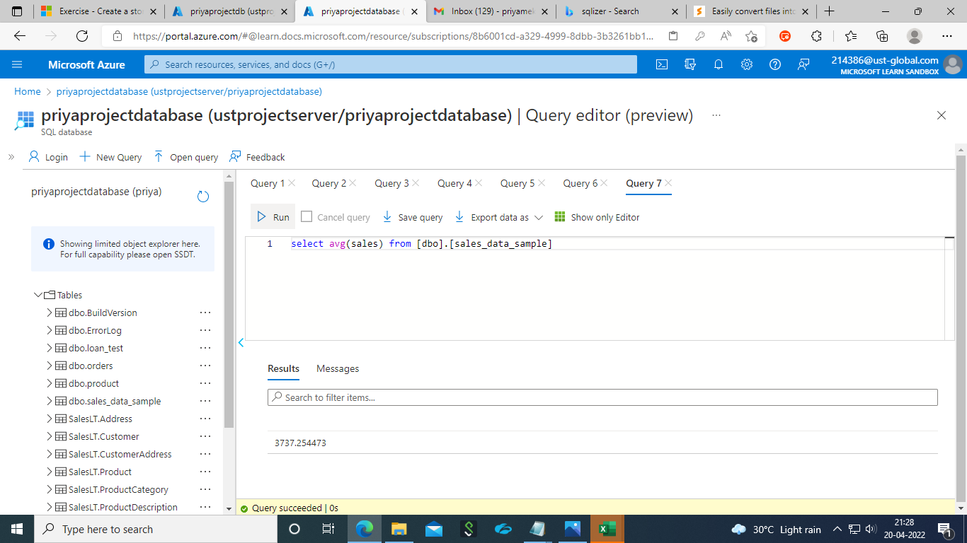
SAMPLE DATABASEWITH DIMENSIONS AND FACT TABLES –TO ESTIMATE THE UNIT SALES OF RETAIL GOODS

Slide 8
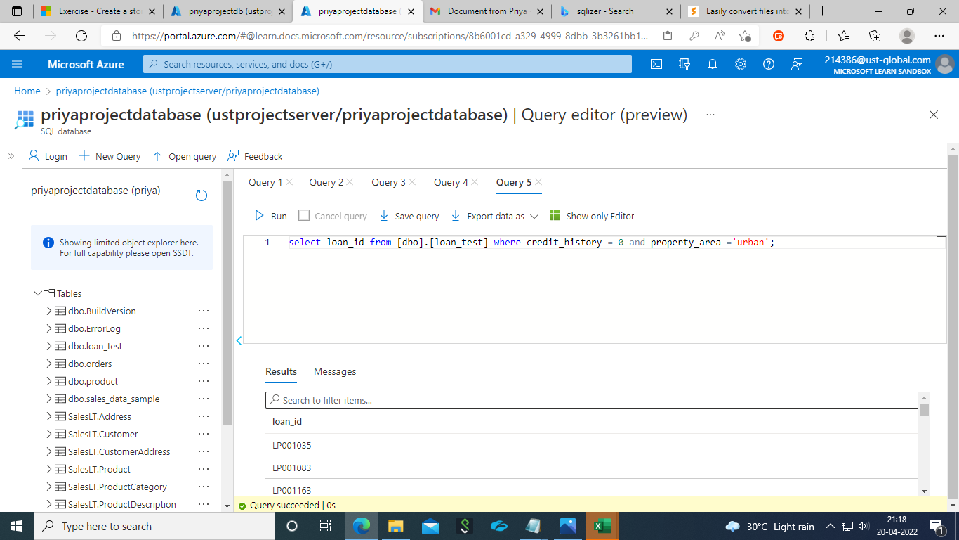
SAMPLE DATABASEWITH DIMENSIONS AND FACT TABLES-FINANCIAL NEED PROGRAMS FOR CONSUMER LOAN PRODUCTS

